Slide 1
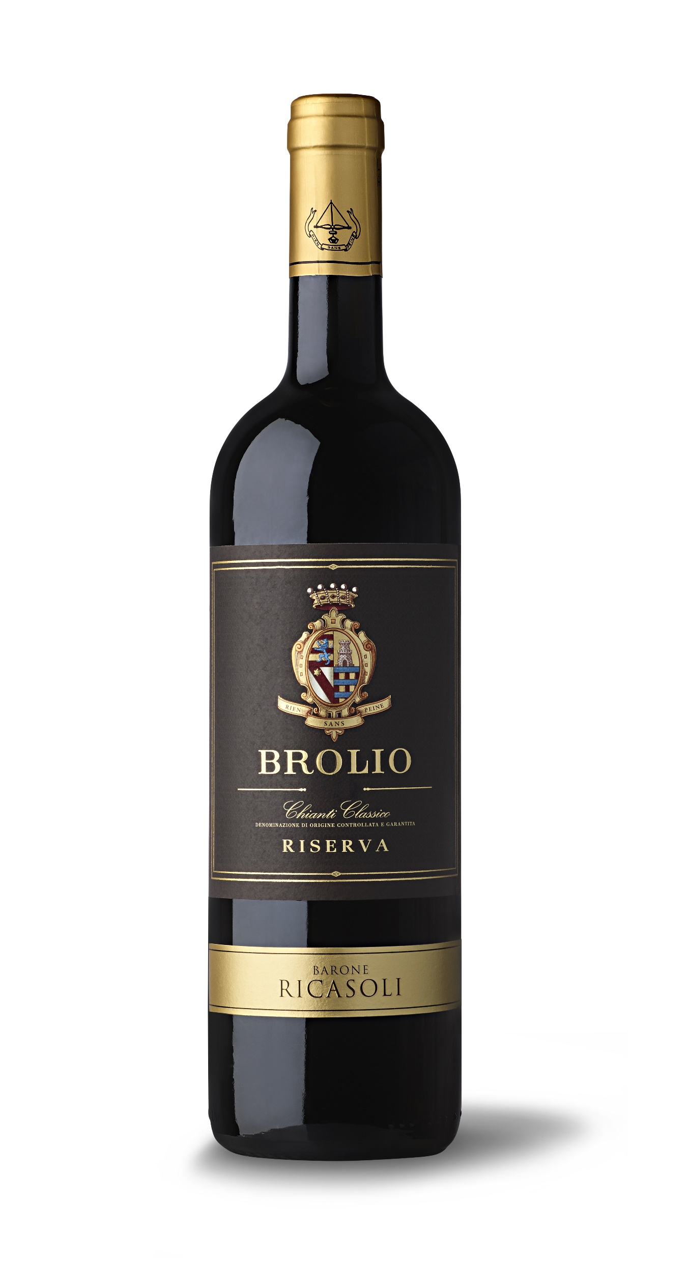
Brolio Chianti Classico Riserva DOCG 2015
GROWING SEASON
The growing season of 2014/2015 was quite regular without extreme events. Winter was mild with temperatures at freezing only during the end of December and for parts January and February. Although a little cold at the beginning, Spring also showed average temperatures followed by a warm May and June which favored a perfect flowering and veraison. Rainfall was not excessive at only about six inches. Summer began early with high temperatures by the end of June recorded at peaks between 93°F and 95°F. July was also particularly warm with peaks at around 104°F. Rainfall was scarce at approximately four inches, but ample water supplies during the Winter and Spring months prevented drought stress. September and October showed perfect weather conditions with significant day-to-night temperature ranges favoring the accumulation of color and polyphenols in the grapes.
TASTING NOTES
Ruby red in color with hints of black fruit, spice, and vanilla on the nose. Round mouthfeel with a balanced acidity
and elegant tannins with a long and pleasant finish.
GRAPE VARIETY
80% Sangiovese, 15% Merlot, 5% Cabernet Sauvignon
WINEMAKING NOTES
Fermentation takes place in stainless steel tanks at controlled temperatures between 75.2°F and 80.6°F with 12 – 16 days of skin contact.
AGING
16 months in barrique and tonneaux followed by another 3 to 6 months of aging in the bottle.

